Slide 1
Web Fundamentals
HTTP - REST
Euricom Front-End Boot Camp

Slide 2
Agenda
Web Concepts TCP/IP, DNS, HTTP, Cookies
Infrastructure Servers, Databases, Load Balancers
Web Services Soap & REST API

Slide 3
Web Concepts

Slide 4
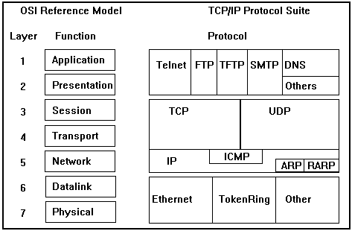
TCP Model
This model is a condensed version of the OSI model and only has four layers. It is considered as standard around internet.
Notes:
Ping = ICMP
TCP vs UDP

Slide 5
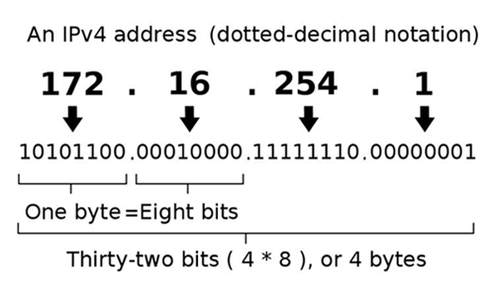
IP Address
IPv4

Slide 6
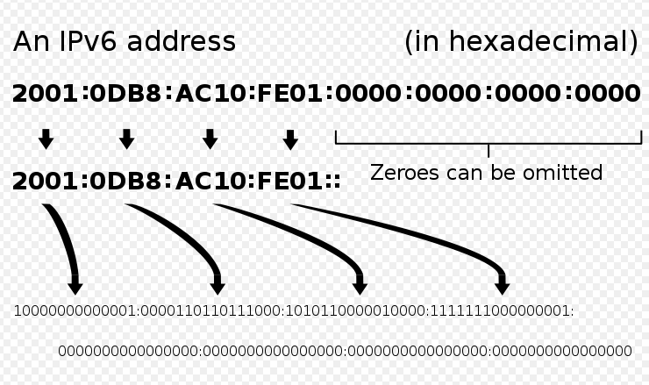
IP Address
IPv6

Slide 7
Domain Name System (DNS)
Name Server
DNS Lookup
1
Browser
bookmarks.rediff.com => 210.210.93.86
Internet
BIND, PowerDNS, djbdns
2
3
Web Server
4
HTTP Response
IIS, Apache, Lighttpd etc.
http://bookmarks.rediff.com/recent/

Slide 8
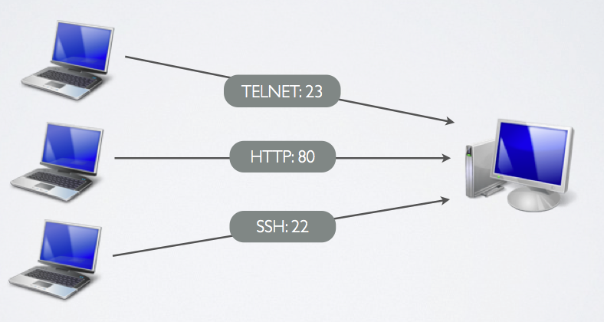
Port Numbers
A port is an endpoint to a logical connection and the way a client program specifies a specific server program on a computer in a network
Notes:
Port numbers range from 0 to 65536, but the first 1024 are reserved for privileged services. The other ports could be used by any application.

Slide 9
URL
Uniform Resource Locator (URL)
It is just a formatted string, consisting of:
Protocol for communicating with the server (e.g., http, ftp, https, ...)
Name of the server or IP address + optional port (e.g. www.telerik.com, mail.bg:8080)
Path and name of the resource (e.g. index.php)
Parameters (optional, e.g. ?id=27&lang=en)
http://www.euri.com/about

Slide 10
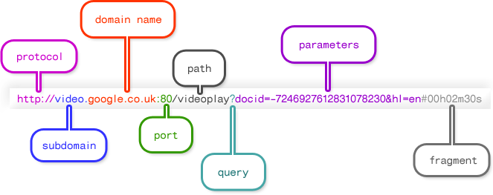
URL

Slide 11
URL
URLs are encoded according RFC 1738:
All other characters are escaped with the formula:
Example: space has decimal code 32, in hex – 20, so space in URL becomes %20
Space can also be encoded as "+"
“... Only alphanumeric [0-9a-zA-Z], the special characters $-_.+!*'() and reserved characters used for their reserved purposes may be used unencoded within an URL.”
%[character hex code in ISO-Latin character set]

Slide 12
HTTP protocol
Hypertext Transfer Protocol.
HTTP provides a set of rules and standards that govern how information is transmitted on the World Wide Web.
The HTTP protocol is fundamental for WWW

Slide 13
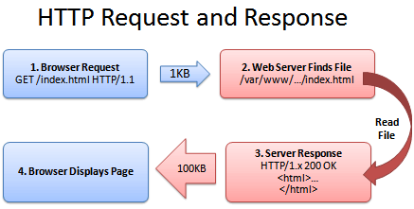
HTTP
HTTP 1.0 / 1.1
HTTPS (S for Secure)
They say HTTP is stateless.

Slide 14
HTTP
HTTP request:
HTTP response:
GET /academy/about.aspx HTTP/1.1
Host: www.example.com
User-Agent: Mozilla/5.0
<CRLF>
The empty line denotes the end of the request header
HTTP/1.1 200 OK
Date: Mon, 5 Jul 2010 13:09:03 GMT
Server: Microsoft-HTTPAPI/2.0
Last-Modified: Mon, 12 Jul 2010 15:33:23 GMT
Content-Length: 54
<CRLF>
<html><title>Hello</title>
Welcome to our site</html>

Slide 15
HTTP Request
Request message sent by a client consists of
Request line – request method (GET, POST, HEAD, ...), resource URI, and protocol version
Request headers – additional parameters
Body – optional data
E.g. posted form data, files, etc.
<request method> <resource> HTTP/<version>
<headers>
<empty line>
<body>

Slide 16
HTTP Request Methods
HTTP request methods:
GET
Return the specified resource, run a program at the server, or just download file, …
POST
Update a resource, provide input data for processing at the server, …
HEAD
Return the meta-data associated with a resource (headers only)
Others

Slide 17
HTTP GET Request
Example:
GET /academy/winter-2009-2010.aspx HTTP/1.1
Host: www.telerik.com
Accept: */*
Accept-Language: bg
Accept-Encoding: gzip, deflate
User-Agent: Mozilla/4.0(compatible;MSIE 6.0; Windows NT 5.0)
Connection: Keep-Alive
Cache-Control: no-cache
<CRLF>
HTTP request line
HTTP headers
The request body is empty

Slide 18
HTTP GET Request
Example of HTTP conditional GET request:
Fetches the resource only if it has been changed at the server
Server replies with “304 Not Modified” if the resource has not been changed
Or “200 OK” with the latest version otherwise
GET /academy/join.aspx HTTP/1.1
Host: www.example.com
User-Agent: Gecko/20100115 Firefox/3.6
If-Modified-Since: Tue, 9 Mar 2010 11:12:23 GMT
<CRLF>

Slide 19
HTTP POST Request
Example:
POST /webmail/login.phtml HTTP/1.1
Host: www.abv.bg
Accept: */*
Accept-Language: bg
Accept-Encoding: gzip, deflate
User-Agent: Mozilla/4.0(compatible;MSIE 6.0; Windows NT 5.0)
Connection: Keep-Alive
Cache-Control: no-cache
Content-Length: 59
<CRLF>
LOGIN_USER=mente
DOMAIN_NAME=abv.bg
LOGIN_PASS=top*secret!
<CRLF>
HTTP request line
HTTP headers
The request body contains the submitted form data

Slide 20
HTTP Response
Response message sent by the server
Status line – protocol version, status code, status phrase
Response headers – provide meta data
Body – the contents of the response (the requested resource)
HTTP/<version> <status code> <status text>
<headers>
<CRLF>
<response body – the requested resource>

Slide 21
HTTP Response
Example:
Response status line
HTTP/1.1 404 Not Found
Date: Fri, 17 Jul 2010 16:09:18 GMT+2
Server: Apache/2.2.14 (Linux)
Connection: close
Content-Type: text/html
<CRLF>
<HTML><HEAD>
<TITLE>404 Not Found</TITLE>
</HEAD><BODY>
<H1>Not Found</H1>
The requested URL /img/logo.gif was not found on this server.<P>
<HR><ADDRESS>Apache/2.2.14 Server at Port 80</ADDRESS>
</BODY></HTML>
HTTP response headers
The HTTP response body

Slide 22
Content-Type and Disposition
The Content-Type header at the server specifies how the output should be processed
Examples:
UTF-8 encoded HTML page. Will be shown in the browser.
Content-Type: text/html; charset=utf-8
Content-Type: application/pdf
Content-Disposition: attachment;
filename="Financial-Report-April-2010.pdf"
This will download a PDF file named Financial-Report-April-2010.pdf

Slide 23
HTTP Response Codes
HTTP response code classes
1xx: informational (e.g., “100 Continue”)
2xx: success (e.g., “200 OK”)
3xx: redirection (e.g., “304 Not Modified”, "302 Found”, “301 Moved Permanent)
4xx: client error (e.g., “404 Not Found”)
5xx: server error (e.g., “503 Service Unavailable”)

Slide 24
Browser Redirection
HTTP browser redirection example
HTTP GET requesting a moved URL:
The HTTP response says the browser should request another URL:
GET / HTTP/1.1
Host: academy.telerik.com
User-Agent: Gecko/20100115 Firefox/3.6
<CRLF>
HTTP/1.1 301 Moved Permanently
Location: http://www.telerik.com/academy/
…

Slide 25
HTTPS
HTTPS stands for Hypertext Transfer Protocol over Secure Socket Layer, or HTTP over SSL.
SSL acts like a sub layer under regular HTTP application layering
HTTPS encrypts an HTTP message prior to transmission and decrypts a message upon arrival.

Slide 26
HTTPS
HTTPS by default uses port 443 as opposed to the standard HTTP port of 80.
URL's beginning with HTTPS indicate that the connection between client and browser is encrypted using SSL

Slide 27
Cookies
Cookies are small pieces of data stored by the client on behalf of the server
Included in all future HTTP requests to the server
Response
Set-Cookie: XYZ
Next request
Cookie: XYZ

Slide 28
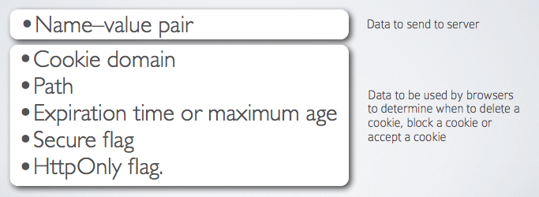
Cookie Content
A web browser is expected to be able to store at least 300 cookies of 4 kb each, and at least 20 cookies per server or domain.

Slide 29
Cookies
Through HTTP Headers
Type of Cookies
Persistent
Session
Secure Cookie
HTTP Only Cookie

Slide 30
How cookies work?
GET /index.html HTTP/1.1 Host: bookmarks.rediff.com
1) Request from Browser
2) Response from Web server
HTTP/1.1 200 OK Content-type: text/html Set-Cookie: name=value; expires=date; path=/; domain=.rediff.com (content of page)
expires=Fri, 31-Dec-2027 23:59:59
GET /popular/ HTTP/1.1 Host: bookmarks.rediff.com Cookie: name=value Accept: */*
3) 2nd request from browser

Slide 31
Use of Cookies
Session Management
Shopping Cart, Authentication
Personalization
Remember me, Preferences
Tracking & Analytics
Ads, Browsing History, Analytics, Tracking

Slide 32
Web Services

Slide 33
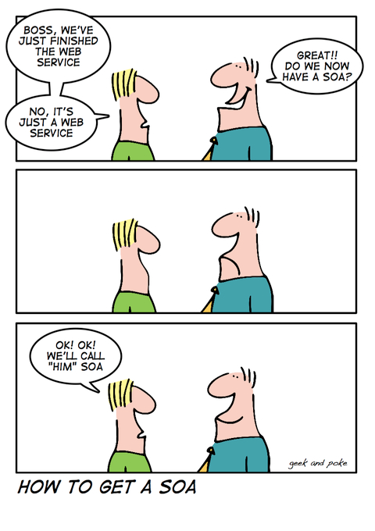
SOA

Slide 34
Web Services
SOAP

Slide 35
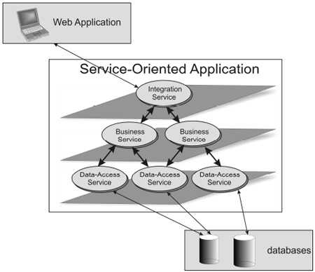
Service Oriented Architecture

Slide 36
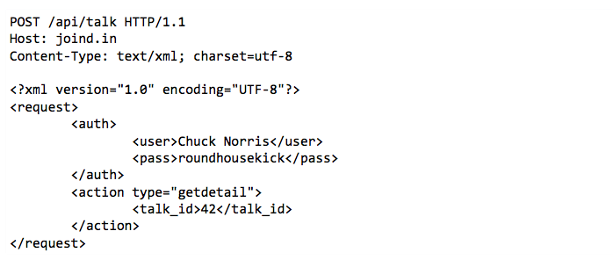
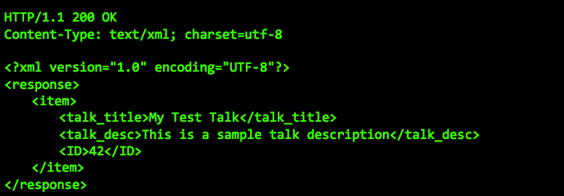
XML Web Service

Slide 37
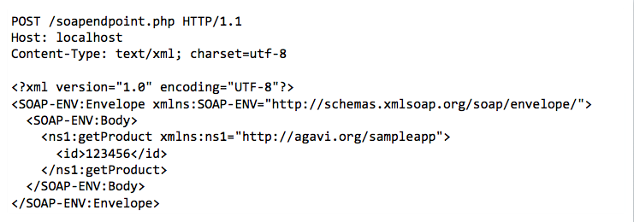
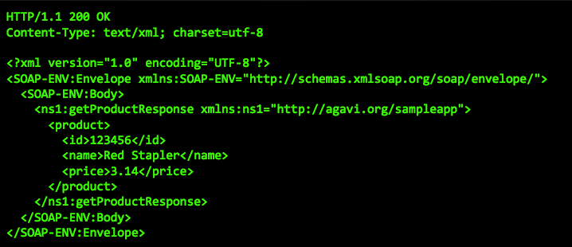
SOAP Web Service

Slide 38
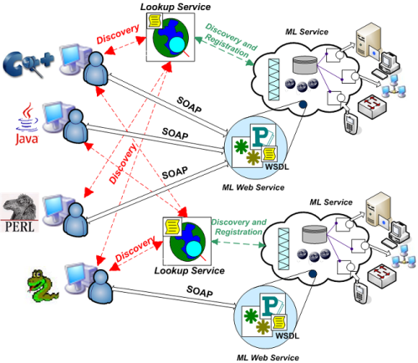
Web Services - SOA

Slide 39

Web Services - SOA
Standards: WS-*

Slide 40
Web Services
REST

Slide 41
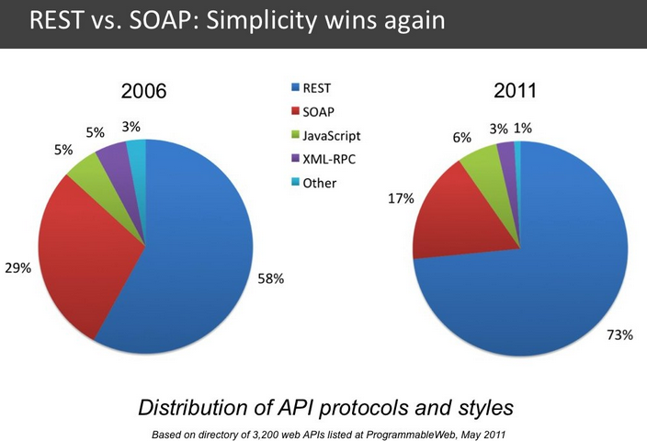
REST

Slide 42
REST Services
Representation State Transfer
Client-Server
Stateless
Cacheable
Layered System
Uniform Interface

Slide 43
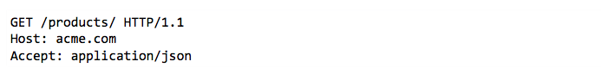
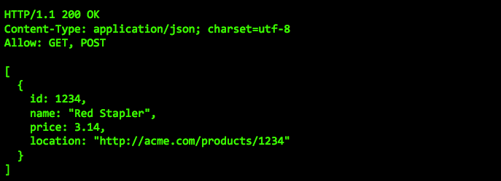
REST (Web) Service

Slide 44
REST Operations
http://www.acme.com/products
GET to retrieve a list of products
POST to create a new product
Returns: 201 Created Location: http://www.acme.com/products/1235

Slide 45
REST Item Operations
http://www.acme.com/products/1234
GET to retrieve
PUT to update a product
DELETE to, you guessed it, delete
Use HTTP status code to indicate result
e.g. HTTP/1.1 409 Conflict

Slide 46
Use RESTfull URL’s
GET /tickets – Retrieve a list of tickets
GET /tickets/12 – Retrieves a ticket
POST /tickets – Creates a new ticket
PUT /tickets/12 – Update ticket #12
PATCH /tickets/12 – Partially updates ticket #12
DELETE /tickets/12 – Deletes ticket #12

Slide 47
How to deal with relations
GET /tickets/12/messages Retrieves list of messages for ticket #12
GET /tickets/12/messages/5 Retrieves message #5 for ticket #12
POST /tickets/12/messages Creates a new message in ticket #12

Slide 48
What about actions that don’t fit into the world of CRUD
Restructure the action to appear like a field. For example: activated field
Treat it like a sub-resource with RESTfull principles. For example, GitHub’s API lets you star a git with PUT /gists/:id/star and unstar with DELETE /gists/:id/star
If there is no way to map the action to a sensible RESTfull structure, don’t use it. For example: /search

Slide 49
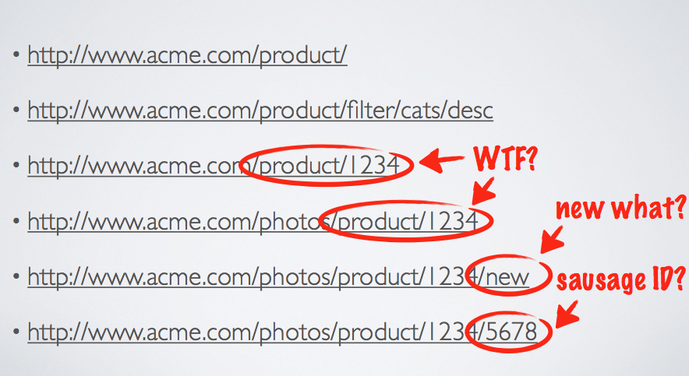
BAD URL’s

Slide 50
API Versioning
Mixed opinions: http://stackoverflow.com/questions/389169/best-practices-for-api-versioning
Major version in URL e.g. GET /v1/tickets
Be backwards-compatible https://stripe.com/docs/upgrades

Slide 51
Result filtering, sorting & searching
Filtering: GET /tickets?state=open
Sorting: GET /tickets?sort=-priority
Searching: GET /tickets?q=return&state=open
Aliases: GET /tickets/recently_closed

Slide 52
Authentication
Don’t use cookies or sessions
Always use HTTPS
Authorization header
Basic HTTP Auth.
OAuth2 : Bearer token

Slide 53
Caching
ETag
ETag containing a hash or checksum of the representation.
If-None-Match header
Last-Modified
Works like ETag, excepts that is uses timestamps
If-Modified-Since header
http://www.w3.org/2005/MWI/BPWG/techs/CachingWithETag.html

Slide 54
HTTP status codes
200 OK Response to a successful GET, PUT, PATCH or DELETE
201 Created Response to a POST that results in a creation
204 No Content Response to a successful request that won't be returning a body (like a DELETE request)
304 Not Modified Used when HTTP caching headers are in play
400 Bad Request The request is malformed, such as if the body does not parse or input validation

Slide 55
HTTP status codes
401 Unauthorized When no or invalid authentication details are provided
403 Forbidden When authentication succeeded but authenticated user doesn't have access to the resource
404 Not found When a non-existent resource is requested
405 Method Not Allowed When an HTTP method is being requested that isn't allowed
422 Unprocessed Entity Used for business validation errors

Slide 56
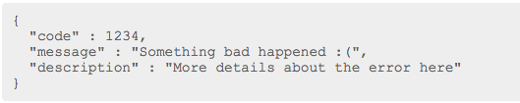
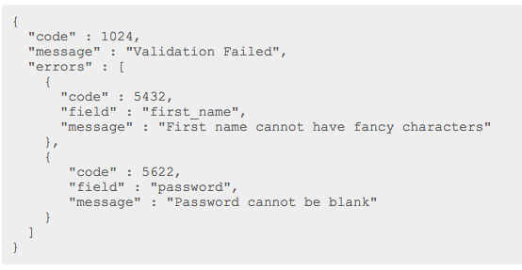
Errors
Try to provide consumable JSON errors
Validation errors for PUT, PATCH and POST requests will need a field breakdown

Slide 57
Web Services
GraphQL

Slide 58
GraphQL
The future of REST API’s

